Slide 1
UGA – Watershed Project
Fall 2016 Capstone Project Review
Factor Five Technologies
Notes:
We are Factor Five Technologies and tonight we are going to be presenting our Capstone Project progress for the Fall of 2016

Slide 2
Agenda
Team Members
Client and Purpose
Project Stakeholders
Stakeholder Map
Project Requirements
Current Client Challenges
Overall Project Solution
Application Workflow
Wireframes
Technology Platform
Use Case
Project Plan
Project Team Challenges
Key Takeaways
Questions

Slide 3
Team Factor Five Members
Nhia Vang
Brian Way
Michael Crawley
Glen Falk
Mathew Alexander

Slide 4
Capstone Project – Client and Purpose
Watershed UGA (https://www.watershed.uga.edu/) is an initiative aimed at fostering a sense of stewardship and sustainability through increased awareness-- and eventual restoration-- of the mostly hidden streams and lakes of the Athens campus.
Notes:
The client for our project is Watershed UGA.
Purpose - On a broader scale, make watershed information more accessible to the general public in order to foster a sense of sustainability through increased awareness.
In the short term and the purpose for bringing us in - organize existing data and make it and future data more accessible to students and faculty

Slide 5
Project Stakeholders
Dr. Seth Wenger – Project Sponsor
Todd Rasmussen - Project Liaison
John Dowd - Project Liaison
Michael Lewis - Project Liaison
Scott Connelly Project Liaison
UGA Faculty
UGA Students
Notes:
Overestimated the influence of the technical team (John, Todd, Michael)
Underestimated the UGA faculty and staff stakeholders - According to Seth, the needs of these two groups are highly important and are somewhat driving requirement Seth’s requirement decisions

Slide 6
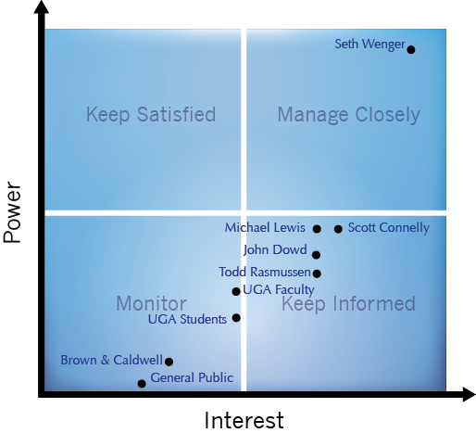
Stakeholder Map
Notes:
Map Based on Interest and Power

Slide 7
Project Requirements
Enhance the existing central repository for watershed data collected via a network of sensors.
Develop a centralized database for data collected manually by faculty and students
Develop a web portal connected to the Watershed UGA web site that renders the manual data in a user-friendly fashion to multiple users

Slide 8
Current Client Challenges
Database dashboard is reading data from a single raw flat-file
Not scalable
Performance issue
Front-end site needs styling improvement for easy readability
No data standardization - data sets
Lack of central repository for data manually collected by faculty and students
Need for web portal to display collected data
Lack of dedicated IT expertise
Notes:
To scale, they would have to create multiple flat files to maintain performance and storage versus just having one central database.
To increase performance, they would have to make the storage smaller on each flat files. Having data in the database, there are more performance tools available (i.e. looking at execution plan and tune SQL statements, creating index, partition on tables, etc...)

Slide 9
Overall Recommended Project Solution
Provide an IT solution to extract, transform, and load data into the database (MySQL)
Recommend and implement data integrity standards
Design, Develop and Deploy database for manual data collection
Design web portal for display of collected data
Notes:
Re-design the database dashboard for readability

Slide 10
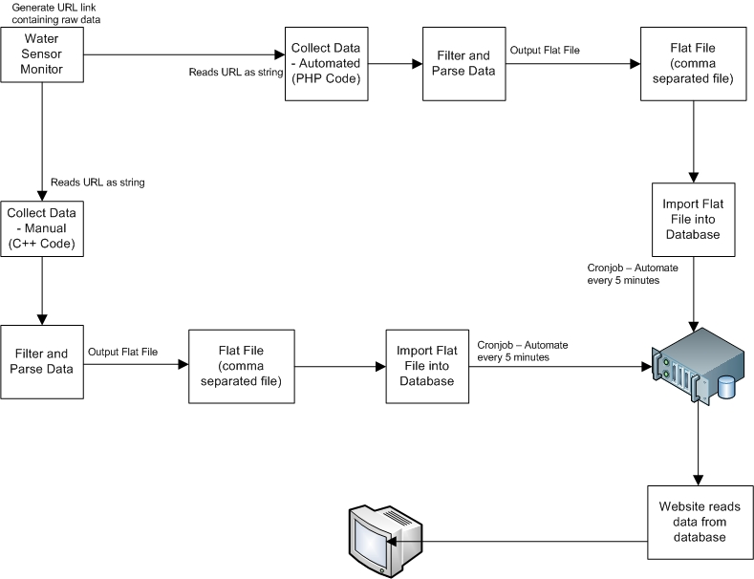
Application Workflow

Slide 11
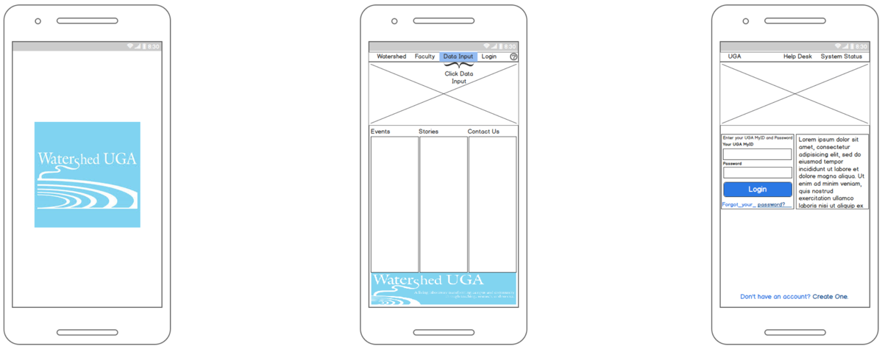
Wireframes – Login Screen
Notes:
o In the next set of slides I will be reviewing the Sitemap Wireframes that utilize a Bootstrap Responsive Design to depict how the site will render across a wide range of devices. Also, I will discuss the Technology Platform that we choose.
o Following the standard IPO technique, we see that these first set of screens illustrate the user’s decision to input data followed by a rudimentary login screen
o Next

Slide 12
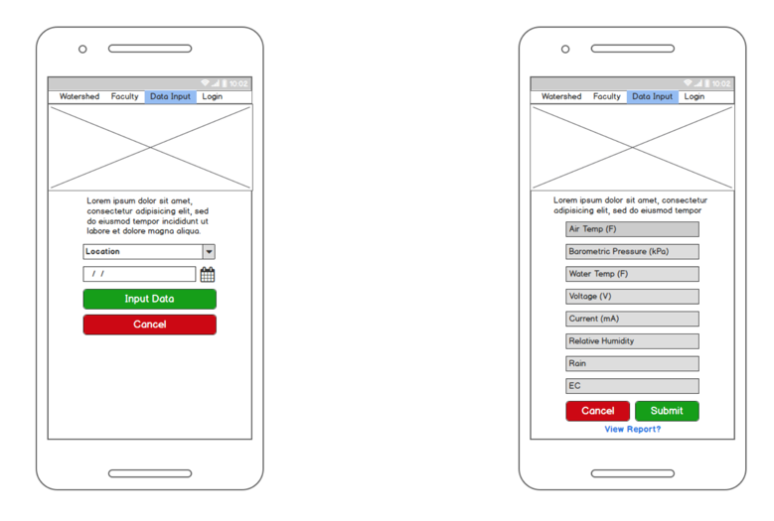
Wireframes – Mobile – Enter Data
Notes:
o The following screens involve the data entry process wherein the user selects the appropriate date and location and is then prompted with an option to either view an associated report or input the mandatory data elements.
o The input screen will be designed to handle exception processing and data validation. From here, the user now proceeds to the output screens.
o Next

Slide 13
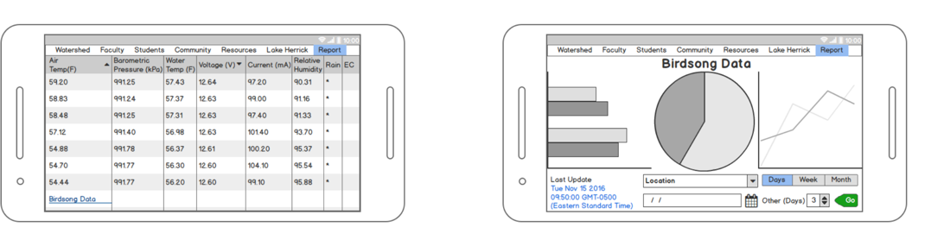
Wireframes – Mobile - View Data
Notes:
o These last set of screens display a graphical representation of the output. On the left is the standard spreadsheet model and on the right is some different variations of formatting options that we have at our disposal; such as a bar chart, pie chart or line chart. o Next
Mobile Responsive

Slide 14
Technology Platform
My SQL server
GitHub
Slack
Php7
Apache HTTP Server
Linux Server
Javascript
JQuery
HTML5
CSS
Notes:
From our meetings with the Stakeholders we have scoped out the following technology platform:
o Database Engine: MySQL
o Repository Hosting Platform: GitHub
o Backend Integration: Linux, PHP
o Application Server: Apache
o Frontend Development: CSS, HTML5, JavaScript, JQuery
o Communication Tool:: Slack
And now I'll turn it over to Mike for the next part of our presentation
Next

Slide 15
Communication Tools
Google Drive
Google Hangouts
Gmail
Slack

Slide 16
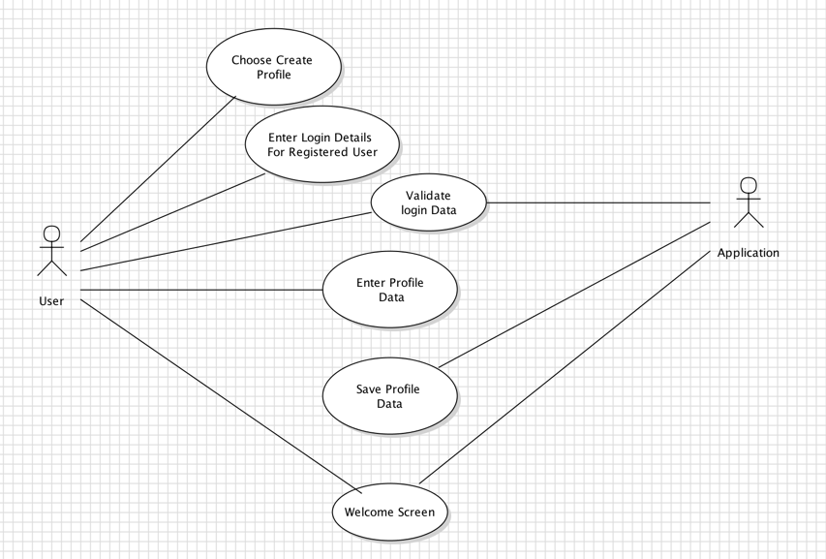
Use Cases- Login
Notes:
The next 4 slides will consist of some UML use case diagrams. 1. explain the reason for using the UML use case diagram and brief overview of the use case

Slide 17
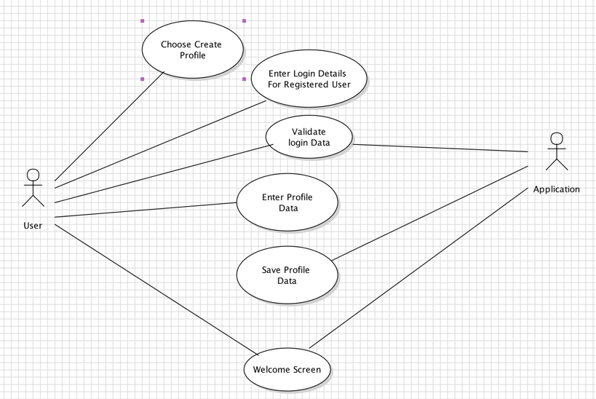
Use Cases- Update Profile
Notes:
M

Slide 18
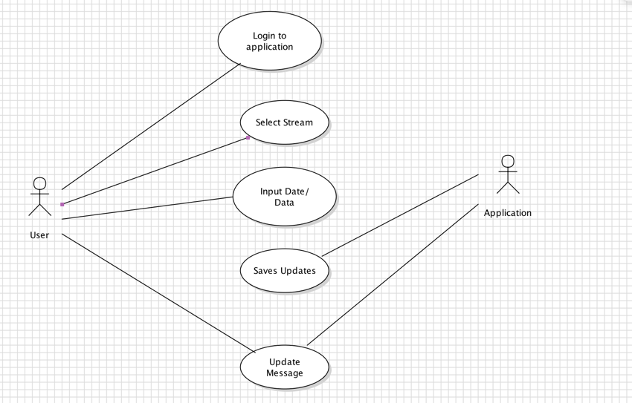
Use Cases- Input Data
Notes:
M

Slide 19
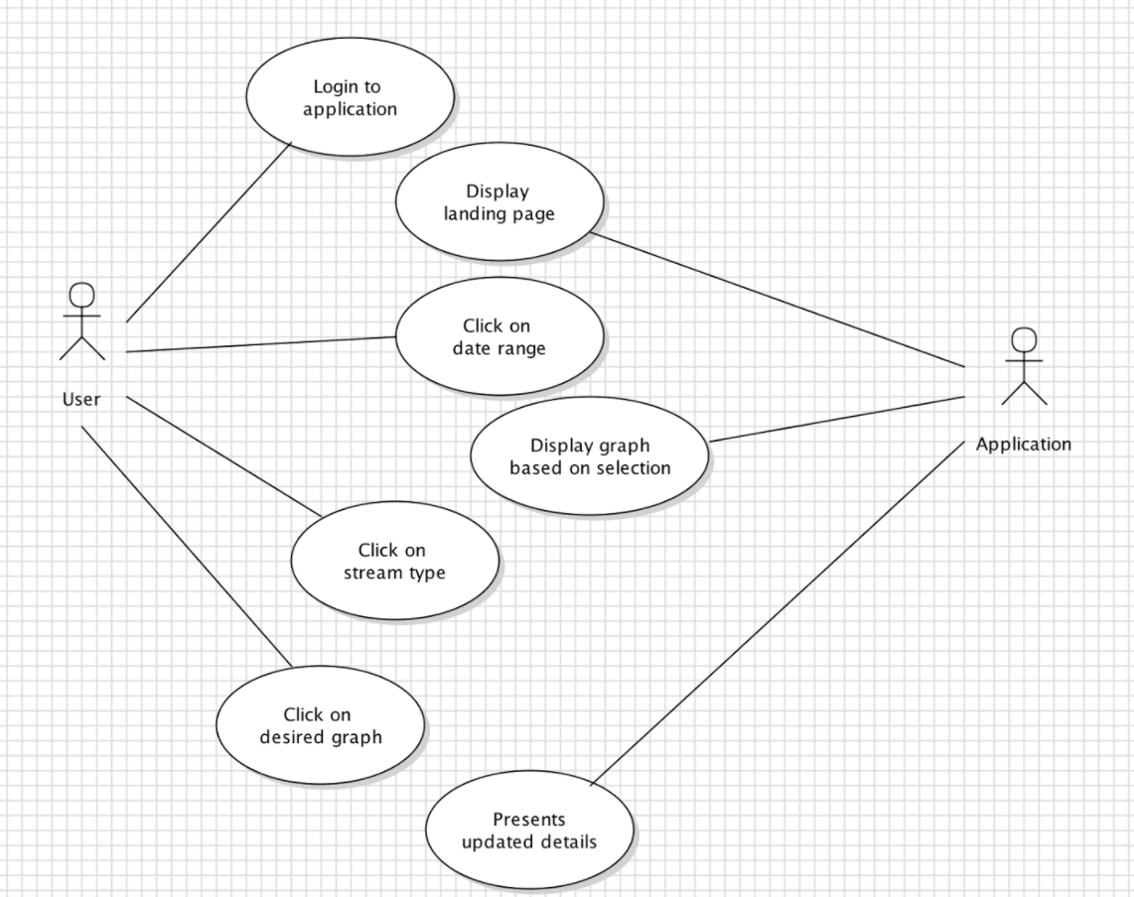
Use Cases- View Data
Notes:
M

Slide 20
Project Plan
MILESTONE | DELIVERABLE | Status / Due Date
Project Charter | Project Charter | In-Progress
Application Framework | Wireframes Application Flow | Completed
Database Architecture | Data Models | In- Progress
Program Content | CSS Standards Images Output Data | Start of Term 2
Technology Architecture | Tech Stack / Architecture | End of Term 1
Build Application - Database | Database model Static Databases Loaded | Start of Term 2
Secure Staging Environment | Set up the staging environment | End of Term 1 /Start of Term 2
Build/Test Application | Working Application | Term 2
Semester 1 Project Binder | Project Binder | December 7, 2016
Semester 2 Project Binder | Final Project Binder | May, 2017
Knowledge Transfer | User Manual | End of Term 2
Production Version | Complete Application | End of Term 2

Slide 21
Project Team Challenges
Learning and developing with new technologies (i.e. PHP-7)
Managing Project Requirements
Managing Scope
Setting Expectations
Managing multiple stakeholders

Slide 22
Key Takeaways
Stakeholder management
Roles
Influence
Power
Risk Assumptions
Failure to deliver on both projects
Lack of succession planning on maintenance
Upsetting stakeholders**
Legacy data incorporation
Learning curve of new technologies
Division of labor between resources
Notes:
not being “aggressive” enough with stakeholders and requirements. Assuming the initial set of stakeholders drove final project requirements.

Slide 23

Questions

